Slide 1



[{{{
How can geographic data find prospect locations for new fitness centers in the City of Waterloo?

Slide 2
Method
Area: City of Waterloo
Ontario, City of Waterloo, Region of Waterloo Open Data:
GRT Stops
Population
Bicycle Parking Areas
Waterbodies
Parks
Google Maps:
Fitness Centres
Car Parking Lots
Convert layers to raster and projection to NAD 1983 UTM Zone 17N

Slide 3
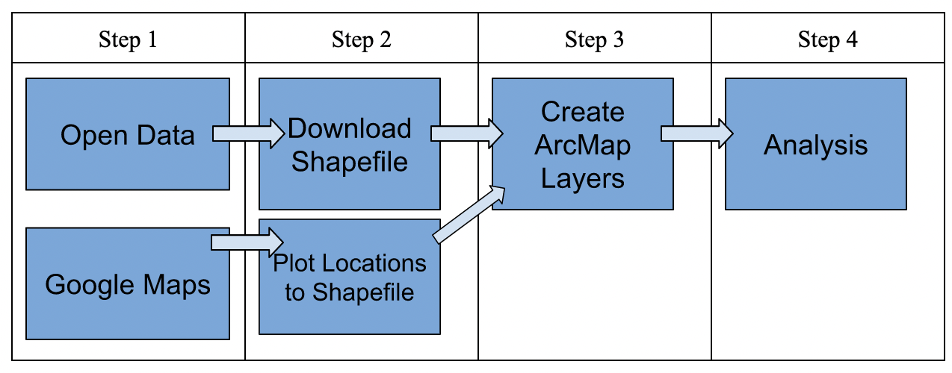
Method

Slide 4
Method
Boolean Model
MCA

Slide 5
Method
ArcMap: Multi Ring Buffer tool for layers
Reclassify to 4 classes
Used reclassified layers in Weighted Overlay tool
Population: 25%
GRT Stops: 25%
Fitness Centers: 30%
Parking Lots: 10%
Bicycle Parking: 10%

Slide 6
Results

Slide 7
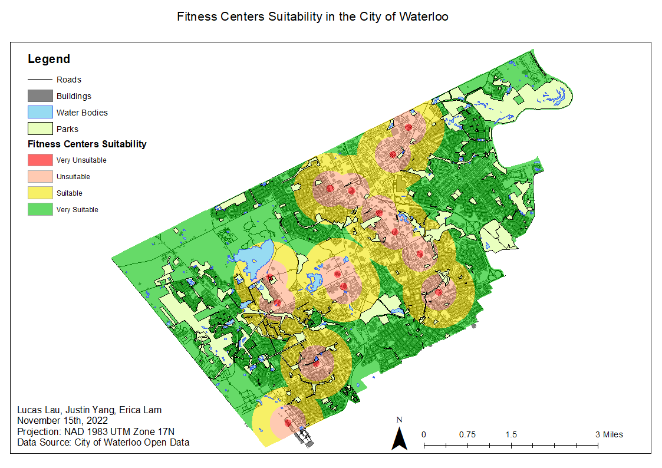
Results
Very suitable: 78.7%
Suitable: 14.2%
Unsuitable: 6.8%
Very unsuitable: 0.3%

Slide 8
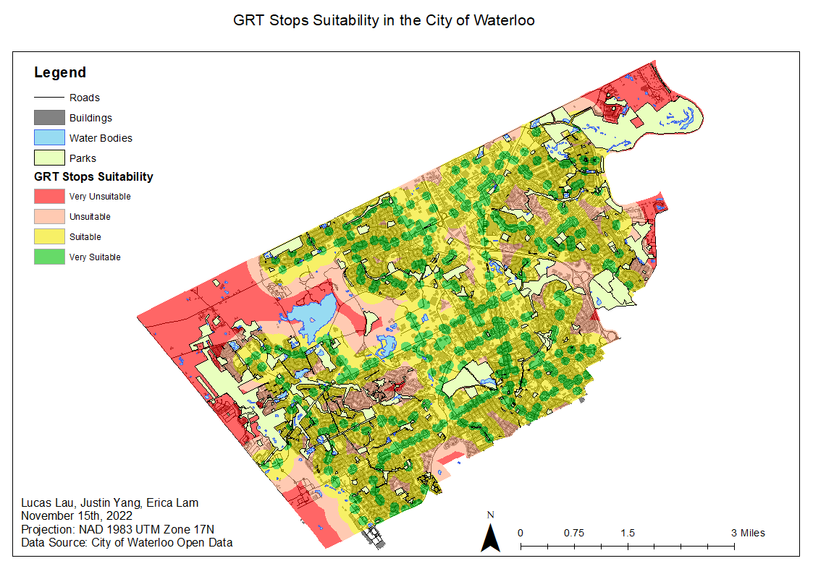
Results
Very suitable: 7.7%
Suitable: 23.9%
Unsuitable: 12.3%
Very unsuitable: 56.1%

Slide 9
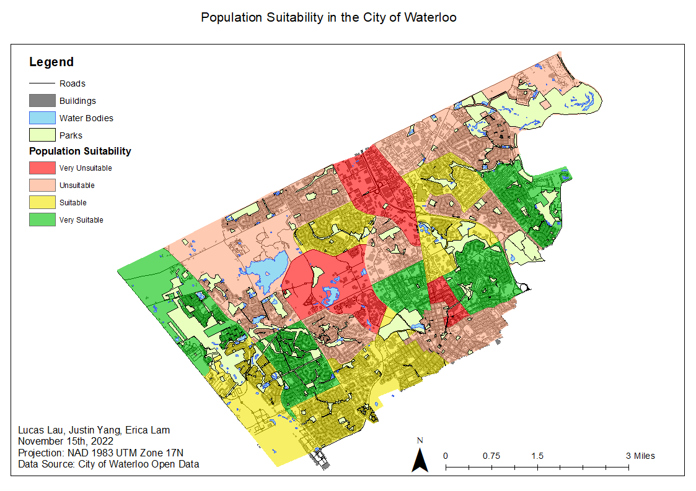
Results
Very suitable: 22.7%
Suitable: 25.5%
Unsuitable: 40.2%
Very unsuitable: 11.6%

Slide 10
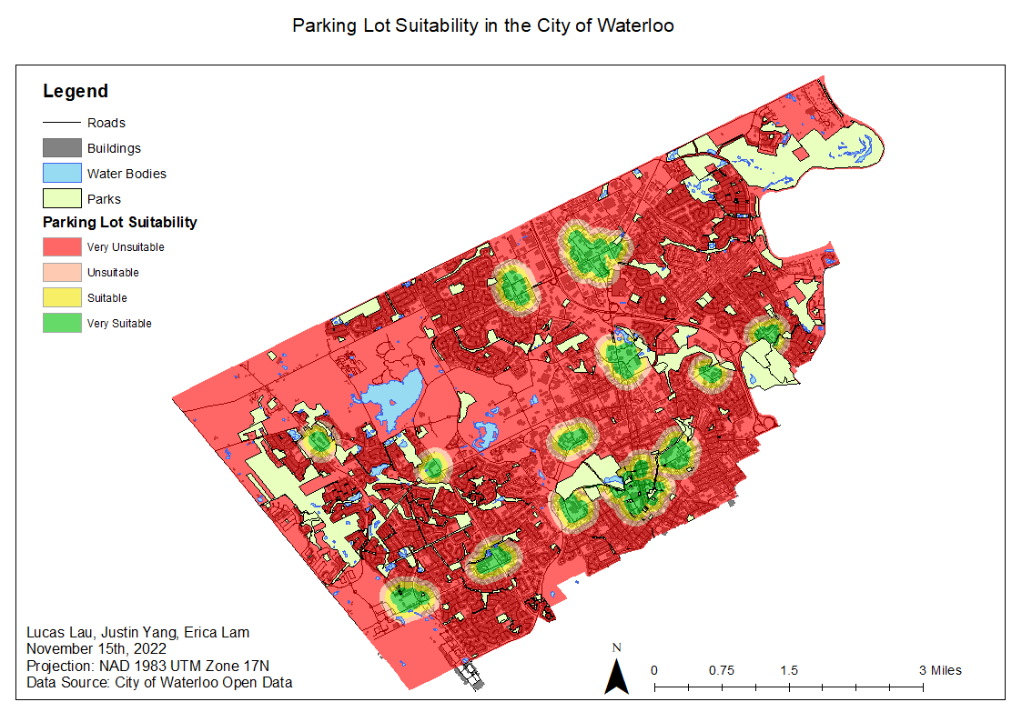
Results
Very suitable: 2.1%
Suitable: 2.1%
Unsuitable: 2.5%
Very unsuitable: 93.3%

Slide 11
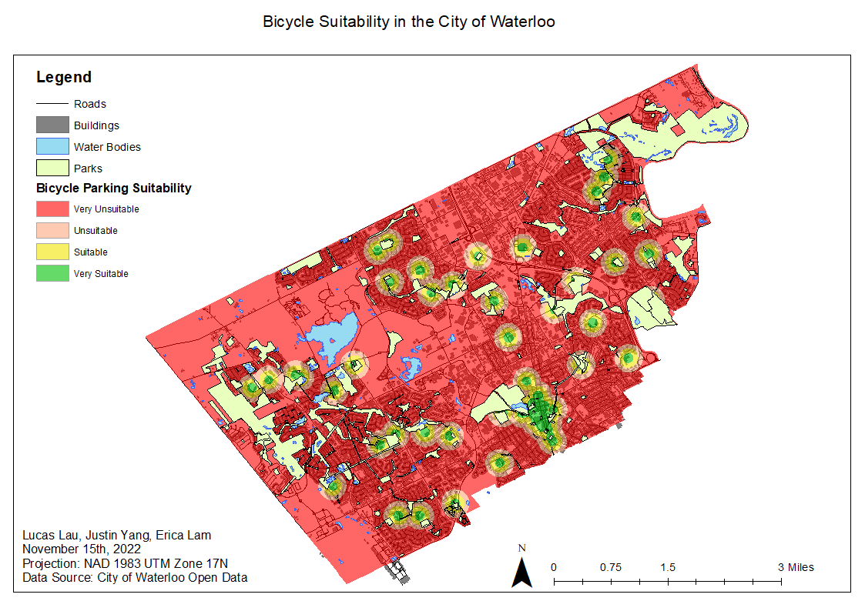
Results
Very suitable: 1.3%
Suitable: 2.9%
Unsuitable: 4.1%
Very unsuitable: 91.7%

Slide 12
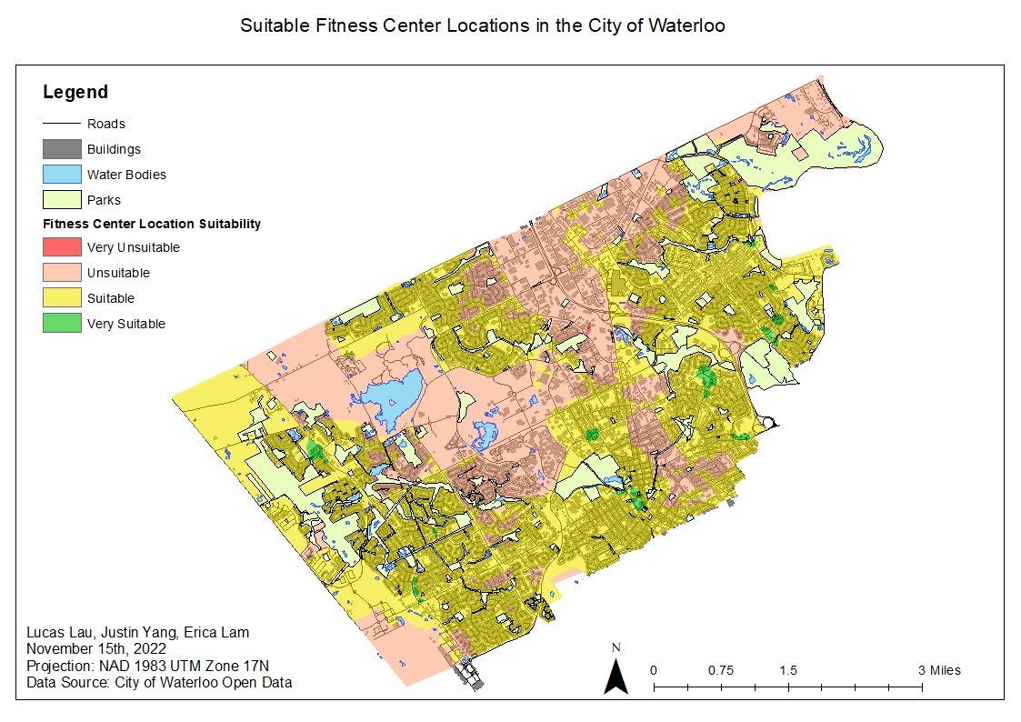
Results
Very suitable: 0.9%
Suitable: 59.8%
Unsuitable: 39.2%
Very unsuitable: 0.01%

Slide 13
Limitations and Constraints
Depends on the number of factors and the influence placed on each one
Time constraint
There are also some constraints placed on the factors that were considered for this study:
Fitness centers were referred to in general instead of as a specific chain or company
Household income was excluded from population data
Not all parking lots were accounted for
Results gathered in this study may not be relevant after a few years

